Slide 1
Database Management Systems Doctor Appointment Booking System
By
2110030110 – J.Laasya Kruthi
2110030100 – E. Srivardhan Reddy
2110030019 – I.N.Chiranjeevi
2110030041 – K.Shikha
Under the guidance of
Mr. Sumit Hazra

Slide 2
Problem statement and domain
In the healthcare service, we propose appointment scheduling problems and various applications and solution approaches in healthcare systems.
The problems are based on the flow of patients, patient preferences, and random arrival time and service.
What we plan to do is to provide the user with a solution to the problem they are facing. It has always fascinated me to imagine that we can get almost everything online then why can’t we get some trusted medical help using the same technology?

Slide 3
Existing solutions/ Naïve solutions
Doctor appointment system is one of those medical technologies that make the lives of patients, doctors, and administration easier.
Making an appointment with a doctor in a few clicks online is one of the solutions that, in our opinion, can make a difference in the interaction between a doctor and a patient.
Benefits of doctor appointment system are
Reducing Patient Wait Times
Simplifying the Process of Finding a Doctor
Increasing Patient Satisfaction
24*7 booking: Anytime Anywhere
Multiple locations and multiple doctors

Slide 4
Proposed Algorithm Design Technique
One of the techniques for doctor appointment booking systems is E-marketing
Patient details such as contact numbers and emails are used for booking through the system. The database of patient information can be used for sending newsletters and the clinic can generate additional revenue.
They are 6 steps to design any pattern for E-marketing
1 Market and Customer Research
2 Selection of the Essential MVP (minimum viable product) Features
3 Design Creation
4 Ensuring Adherence to all the Legal Security Requirements
5 Software Development
6 Testing

Slide 5
Data structures
HashMap
Queues
Array

Slide 6
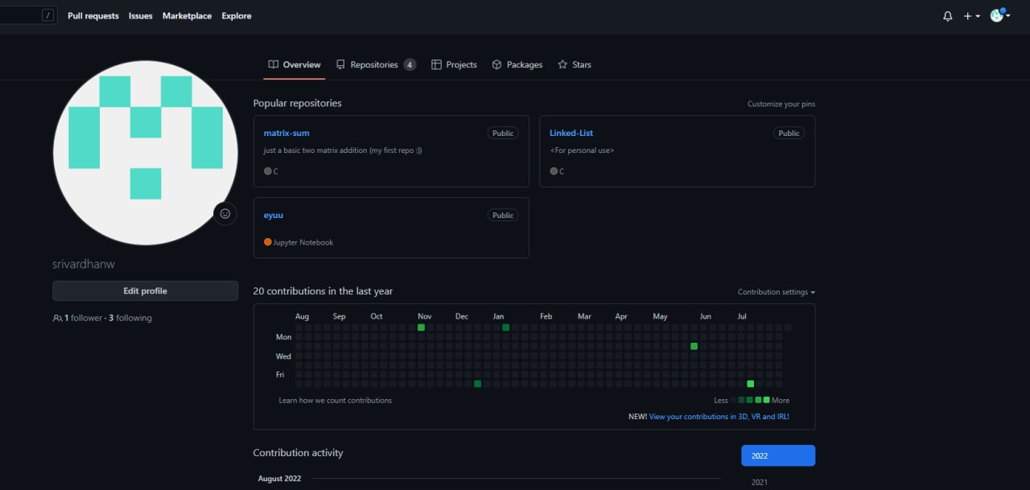
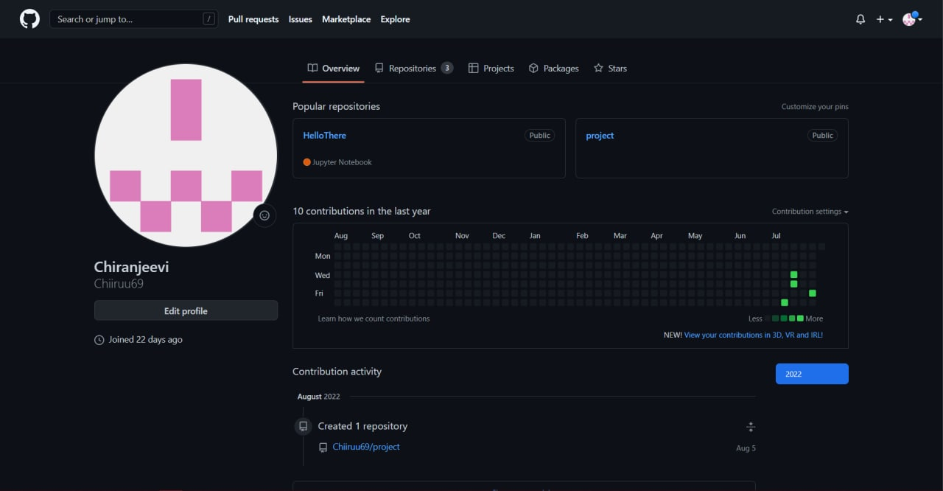
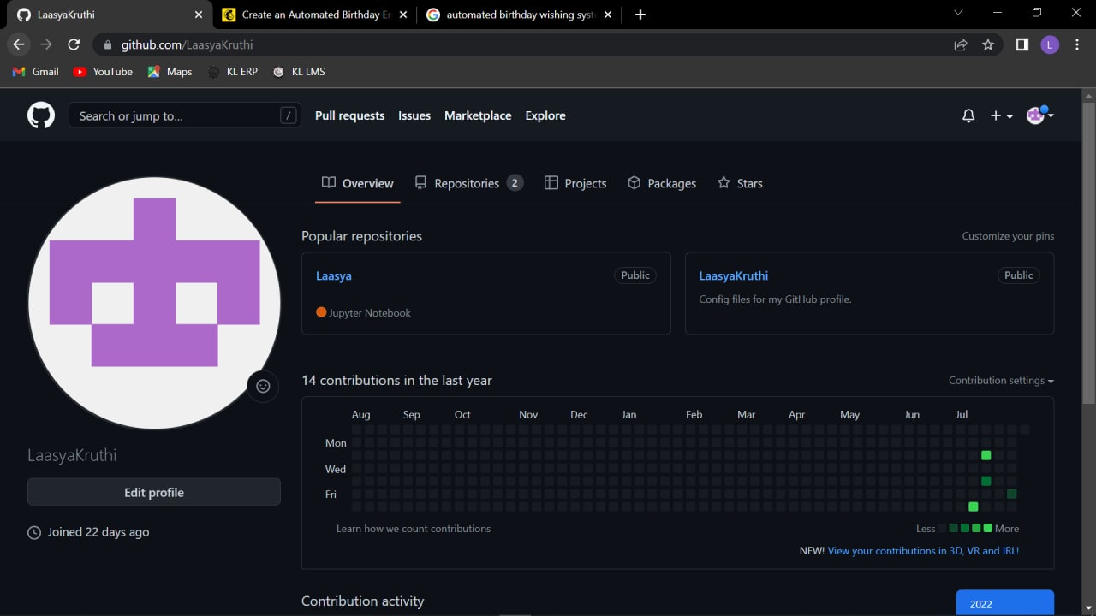
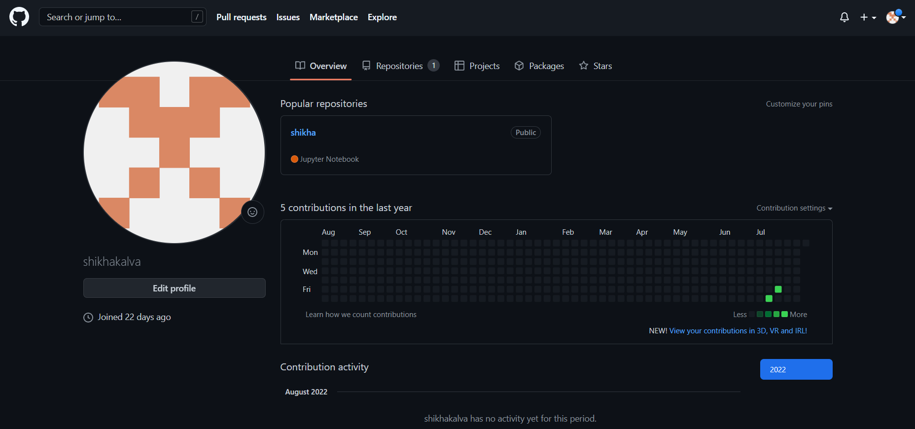
GitHub Setup
GIT HUB SETUP

Slide 7
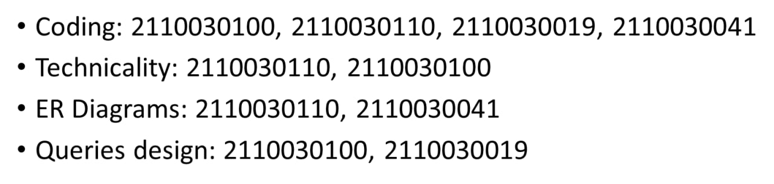
Division of work among the group members
Srivardhan:- Coding,
Chiranjeevi:-
Laasya:-
Shikha:-

Slide 8
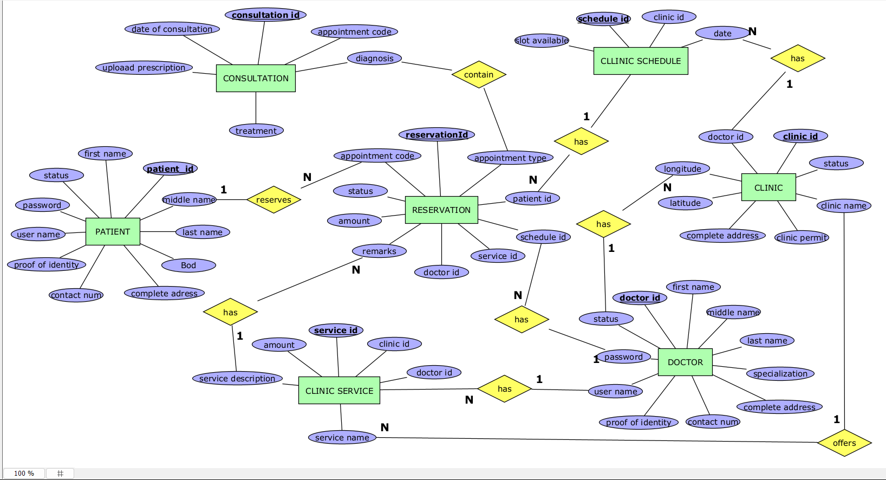

Slide 9


